Slide 1

Qt Introduction
A C++ Framework for Cross-Platform Development

Slide 2
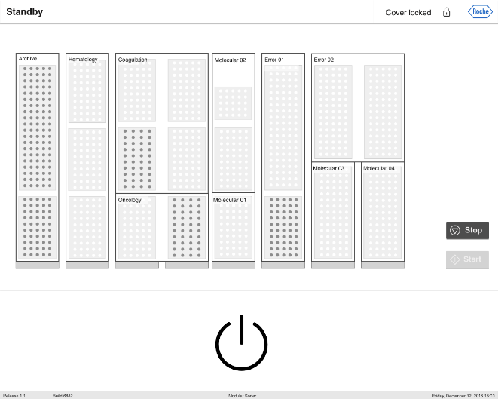



Personal Background
Early experience with Java EE
10+ professional years of C++
Several Projects with Qt
Recent 6 years working focused on Qt/Qml
6+ years of Erni (Barcelona & Germany)
Interested in STL, Modern C++ and Design Patterns

Slide 3

What is Qt?
It’s called Qt (cute) for a reason
Basically, Qt is a Development Framework that was created for improving/facilitating the UI development with C++ for multiple platforms.
Qt API provides additional features for easier cross-platform development and is a light-weight Framework usefull for Development of Embedded and Mobile Applications.
The Qt API is written in C++, but there are several bindings to Qt for other languages as Python (officially maintained), Go, Rust, PHP and Java.

Slide 4
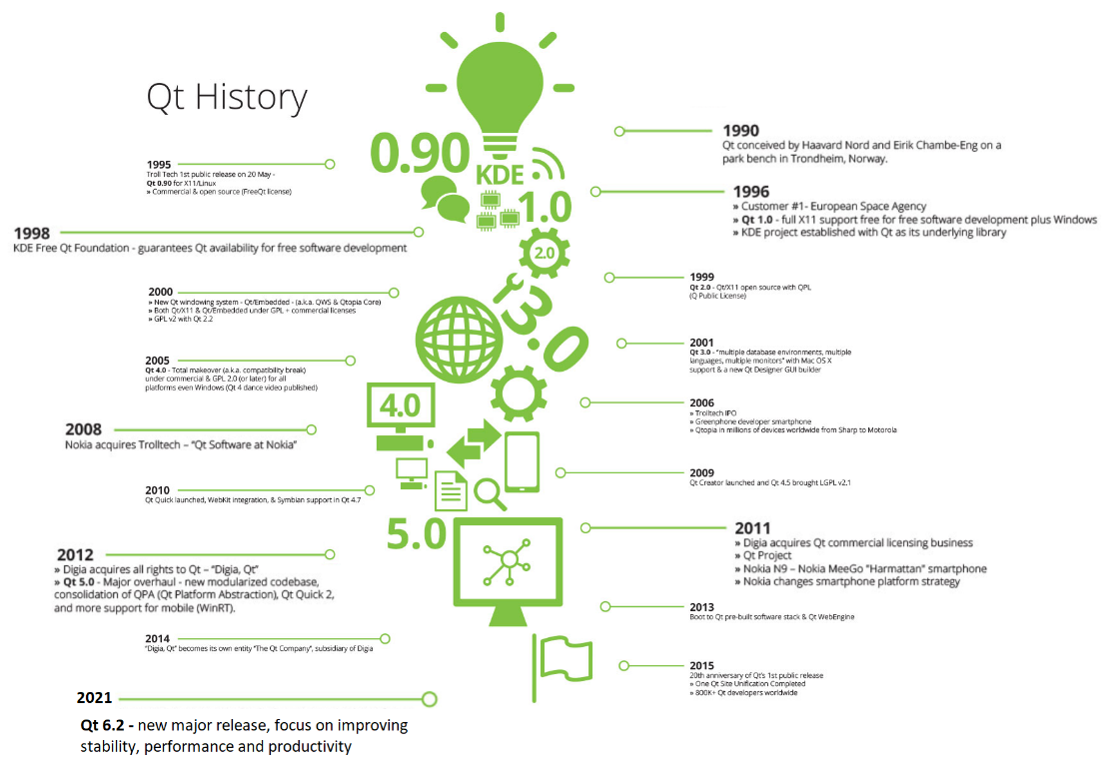
A bit of

Slide 5
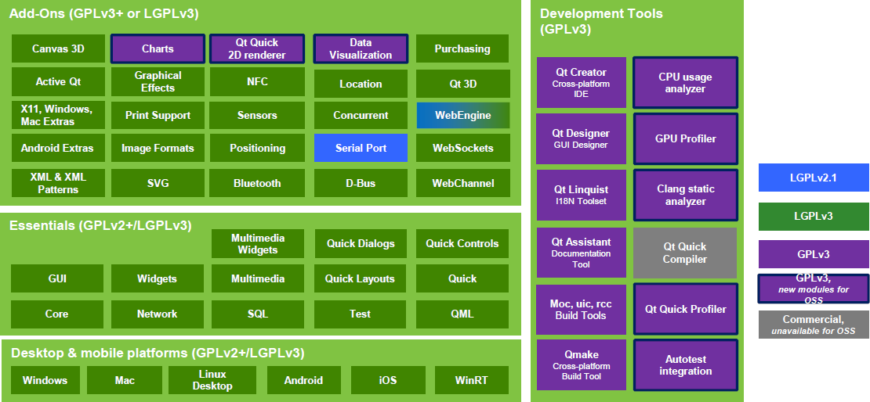
Qt Modules
Notes:
Qt Core: The only required Qt module, containing classes used by other modules, including the meta-object system, concurrency and threading, containers, event system, plugins and I/O facilities.

Slide 6
How much of C++ do you need to know?
Objects and Classes
Declaring a class, inheritance, calling member functions, etc.
Polymorphism
Virtual Methods
Operator Overloading
bool operator == (const Complex& c);
Templates
Limited to the container and concurrent classes

Slide 7
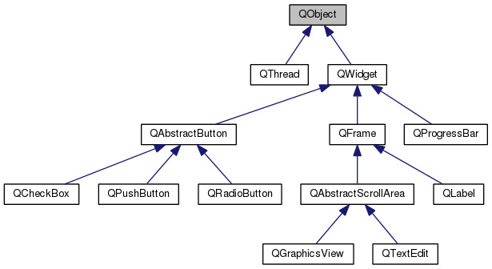
Qt Core - QObject
QObject is the most basic class in Qt and provides some very powerful capabilities like:
object name: you can set a name, as a string, to an object and search for objects by names.
parenting sytem: next topics
Signals and Slots: next topics
Event Management
QObject has no image representation.
It’s used as a base class for most of the classes in Qt.
Macro Q_OBJECT needs to be used on the header of a
class that inherits QObject.

Slide 8
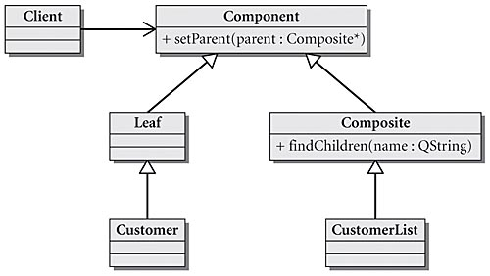
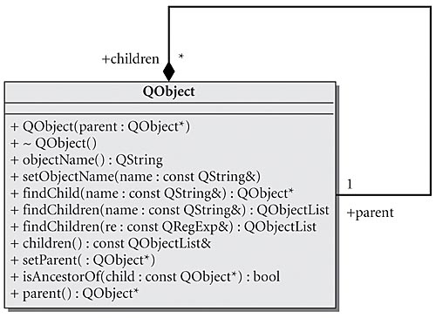
Parenting System
Any object that inherits from QObject can have a parent and children. This hierarchy tree makes many things convenient:
When an object is destroyed, all of its children are destroyed as well. So, calling delete becomes optional in certain cases.
All QObjects have findChild and findChildren methods that can be used to search for children of a given object.
Child widgets in a QWidget automatically appear inside the parent widget.
The child of a QObject must always be created in the thread where the parent was created.

Slide 9
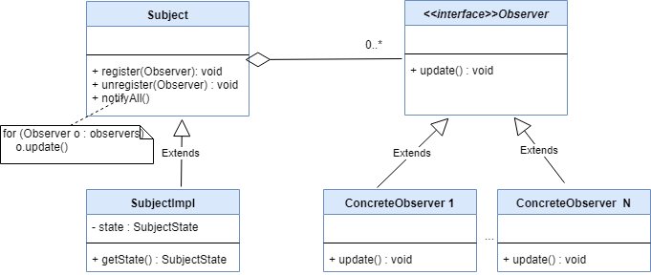
Observer Pattern
Observer pattern is used when an observable object wants to notify other observers objects about a state change. Here are some concrete examples:
A click button triggers a menu to be displayed.
When a web page is completely loaded, a processor class is notified to extract some information from this loaded page.
Observer pattern is used extensively in GUI applications, and often leads to some repetitive code.
Qt was created with the idea of removing this spaghetti code and provide a nice and clean syntax.
The signal and slots mechanism is the answer for this problem.

Slide 10
Signals and Slots
A signal is a message that an object can send, most of the time to inform of a status change.
Button emits a clicked signal.
Timer emits a timeout signal.
A slot is a function that is used to accept and respond to a signal.
Example: A media player might have a class that is used to check the progress of the media. An instance of this class might periodically send a tick signal, with the progress value. This signal can be connected to a QProgressBar, that can be used to display the progress.
SIGNAL: SLOT:
CONNECTION:
void MediaProgressManager::tick(int miliseconds);
void QProgressBar::setValue(int value);
QObject::connect(manager, SIGNAL (tick(int)), progress, SLOT (setValue(int)));

Slide 11
Connecting Signals and Slots
Old Syntax:
New connect to QObject member - Qt 5 :
New connect to simple function - Qt 5:
connect ( sender, SIGNAL( valueChanged( QString, QString ) ), receiver, SLOT( updateValue( QString ) ) );
connect ( sender, &Sender::valueChanged, receiver, &Receiver::updateValue );
connect ( sender, &Sender::valueChanged, someFunction );
connect ( sender, &Sender::valueChanged, [=]( const QString &newValue ) { receiver->updateValue( "senderValue", newValue ); } );

Slide 12
Connection Types
connect (const QObject *sender, const char *signal, const QObject *receiver, const char *method,
Qt::ConnectionType type = Qt::AutoConnection)
Constant | Description
Qt::AutoConnection | (Default) Qt::DirectConnection is used if receiver lives in the same thread as the signal is emitted, otherwise, Qt::QueuedConnection is used. The connection type is determined when the signal is emitted.
Qt::DirectConnection | The slot is invoked immediately when the signal is emitted. The slot is executed in the signalling thread.
Qt::QueuedConnection | The slot is invoked when control returns to the event loop of the receiver's thread. The slot is executed in the receiver's thread.
Qt::BlockingQueuedConnection | Same as Qt::QueuedConnection, except that the signalling thread blocks until the slot returns. This connection must not be used if the receiver lives in the signalling thread, or else the application will deadlock.
Qt::UniqueConnection | This is a flag that can be combined with any one of the above connection types, using a bitwise OR. When Qt::UniqueConnection is set, QObject::connect() will fail if the connection already exists (i.e. if the same signal is already connected to the same slot for the same pair of objects). This flag was introduced in Qt 4.6.

Slide 13
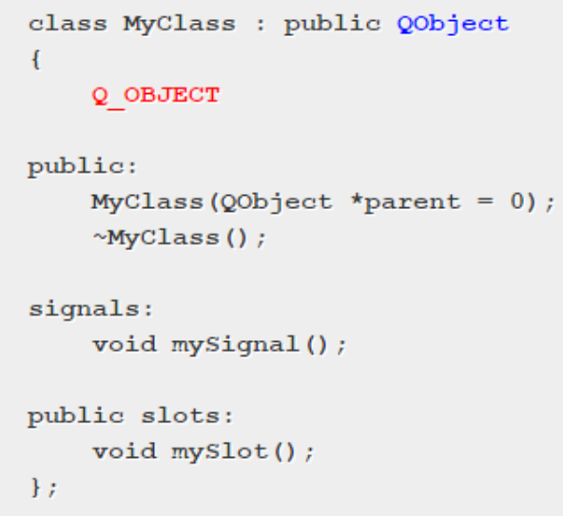
The Meta Object
Qt provides a meta-object system. Meta-object (literally "over the object") is a way to achieve some programming paradigms that are not achieved with pure C++ like:
Introspection: capability of examining a type at run-time
Asynchronous function calls
The meta-object system is based on three things:
The QObject class as a base class.
The Q_OBJECT macro inside the private section to enable meta-object features
The Meta-Object Compiler (moc) supplies implementation of meta-features.

Slide 14
Other Feature and Improvements
Containers: QList, QLinkedList, Qvector, QStack, QQueue, QMap, QMultiMap, QHash, QMultiHash, QSet, QBitArray ...
Compatible with STL’s generic algorithms.
Smart Pointers since 2009: QSharedPointer, QScopedPointer, QWeakPointer, and some others.
Thread Support since 2005: platform-independent threading classes, a thread-safe way of posting events, and signal-slot connections across threads.
File System Support since 2008: platform-independent file system access.

Slide 15
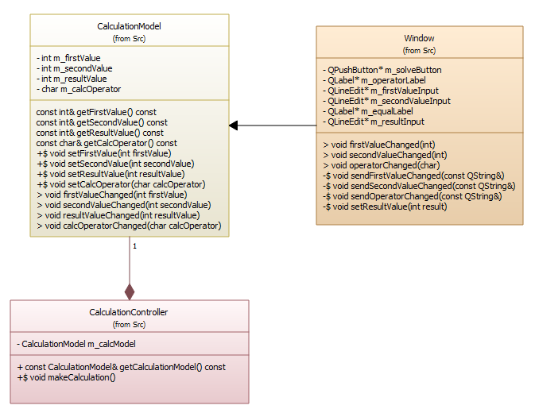
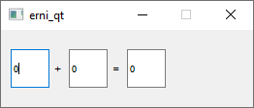
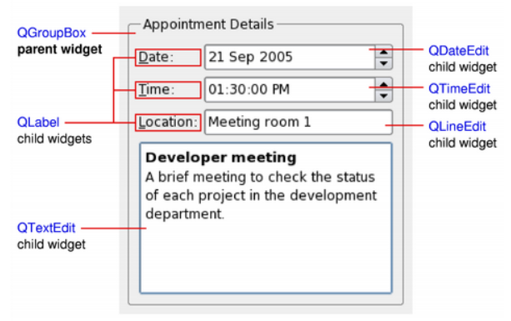
Demo
Gui App with a Window to receive some inputs and then trigger some action

Slide 16
Demo
https://github.com/hebercosfer/qt_intro_demo
Contact
Heber.Costa@betterask.erni

